Slide 1
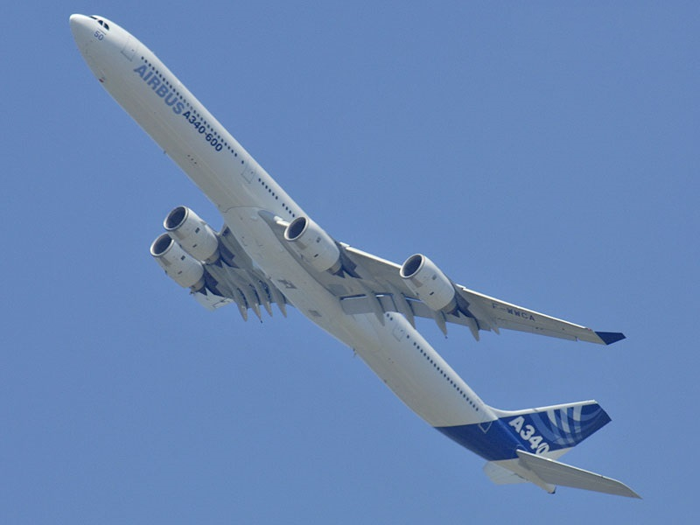
Is air travel the safest way to travel?
Aldana, Mario

Slide 2
Problem Statement:
The Scenario:
Due to recent unfortunate airline crashes, the media has been promoting statistics stating air is no longer a safe way to travel and it is now being presented as one of the most dangerous to the public.
Analysis:
In this analysis, we will see a dashboard with charts and figures about the trends of airline safety. Also, the real facts related to commercial air accidents. We will take a tour through the years, from 1913 to 2009. The charts and figures show the trends of aircraft that have had the most accidents and the places where they have occurred.
Dataset:
Airplane Crashes and Fatalities Since 1908 (Full history of airplane crashes throughout the world, from 1908-2009).

Slide 3
Steps:
Dataset
Airplane Crashes and Fatalities Since 1908 (Full history of airplane crashes throughout the world, from 1908-2009).
Observations 5268, variables 13.
Summary
Visualization
Passengers who were involved in air accidents from 1913 to 2009.
Number of fatalities in air accidents from 1920 to 2009.
Conclusion
Military accidents will not be included.
Statistical Summary of fatalities, aboard (number of passengers), and ground (fatalities on the ground)
Number of passengers aboard with fatalities by year.
Number of passengers aboard and Fatalities (>19) by type airplane between 2005 and 2009.
First type of airplane and its variants that have had the most accidents.
Second type of airplane and its variants that have had the most accidents
Places with the most fatalities between 1999 and 2009 and with fatalities greater than 10.
Trend of air accidents since the beginning of commercial aviation and until 2009
Trends

Slide 4
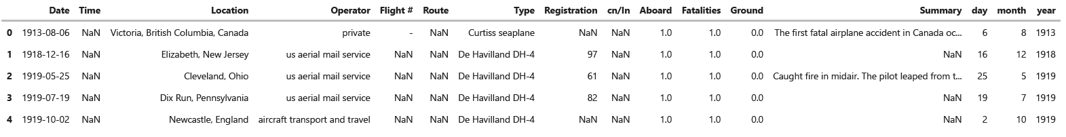
Dataset

Slide 5
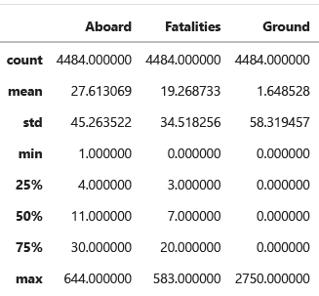
Statistical Summary

Slide 6
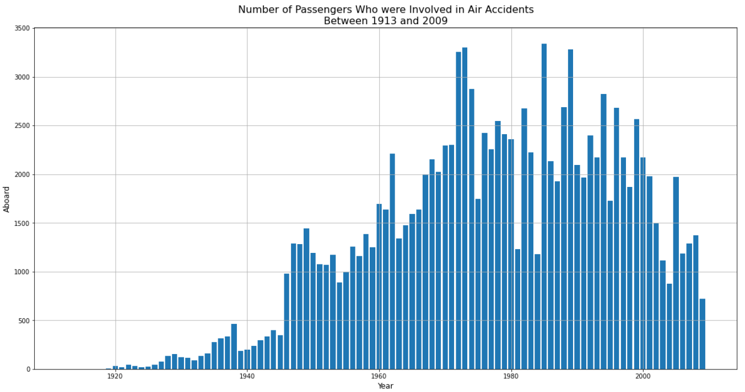

Slide 7
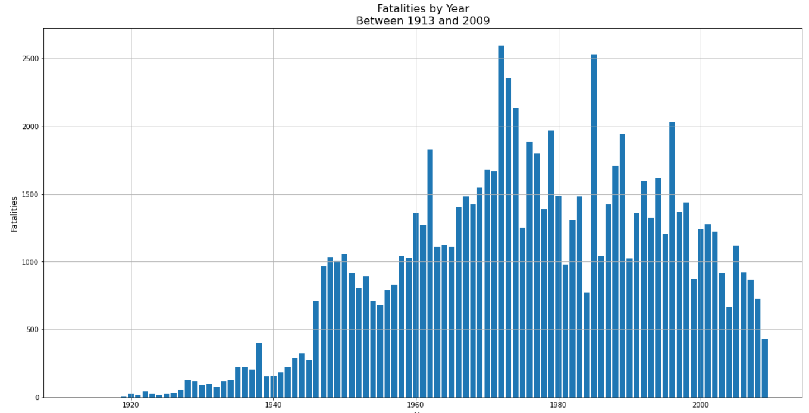

Slide 8
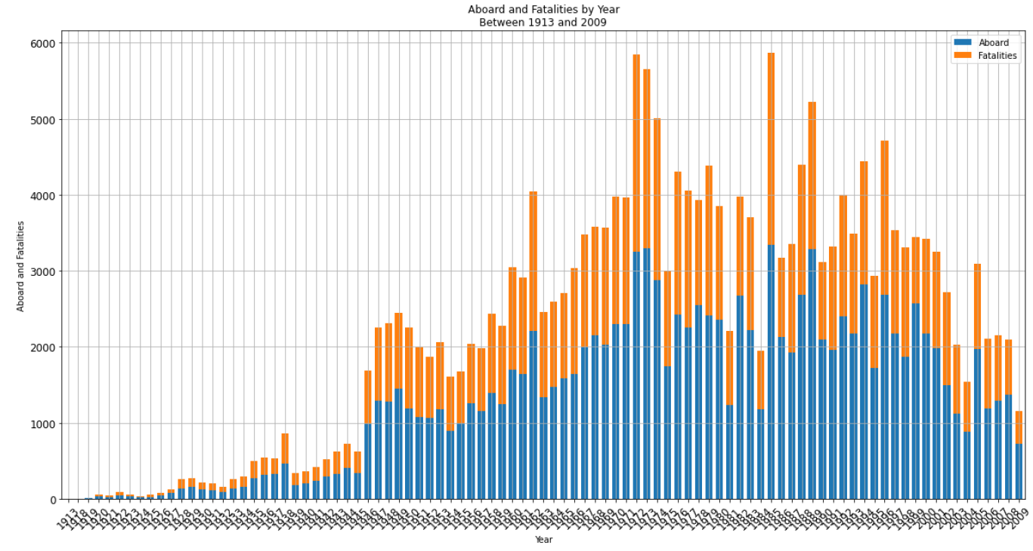

Slide 9
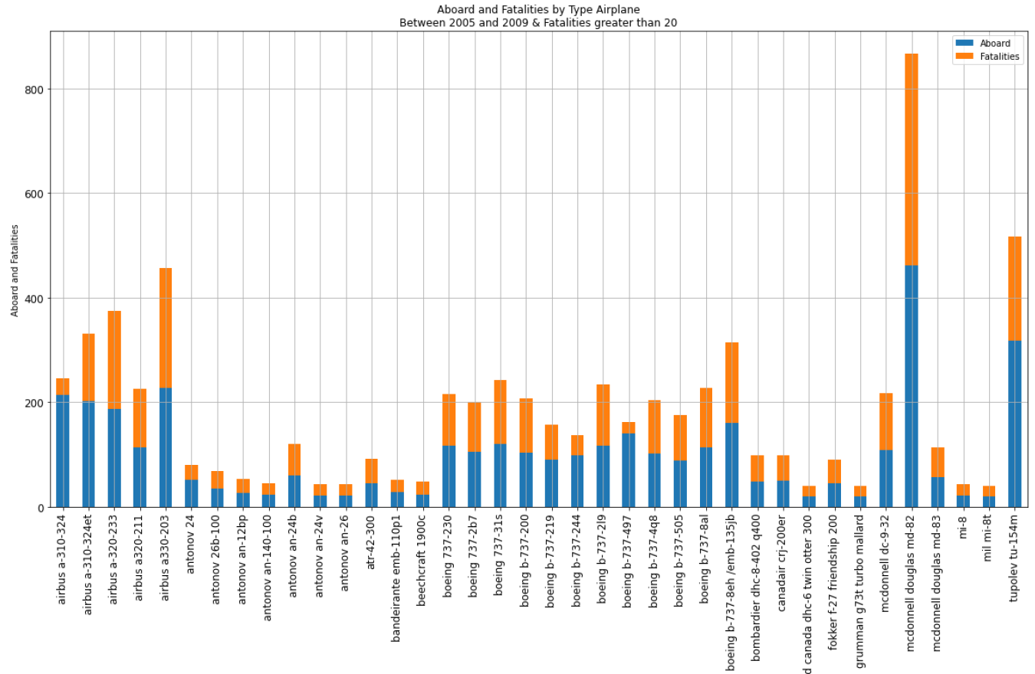

Slide 10
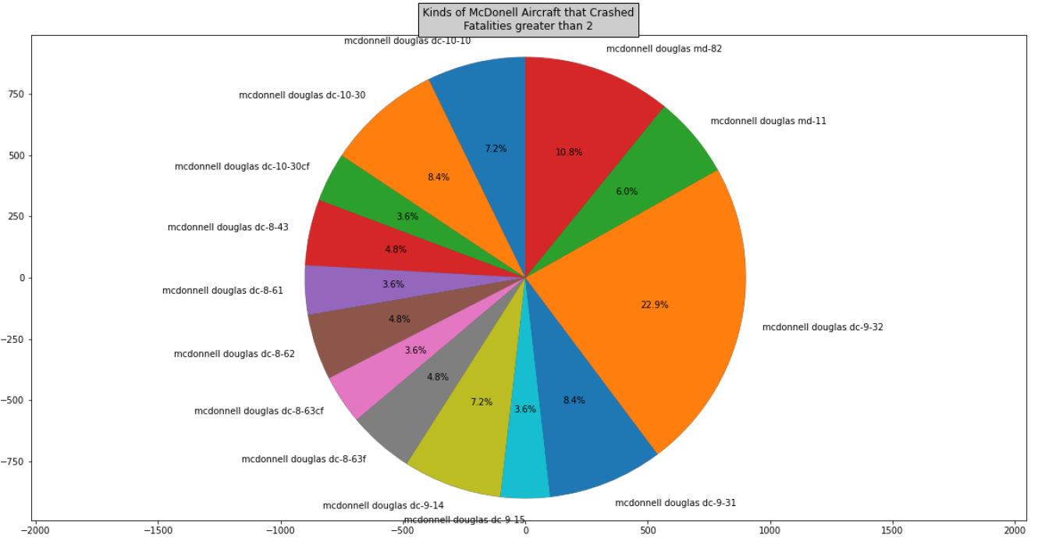

Slide 11
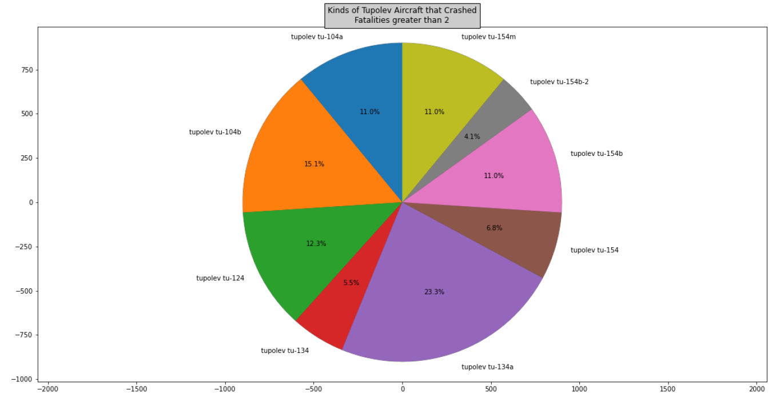

Slide 12
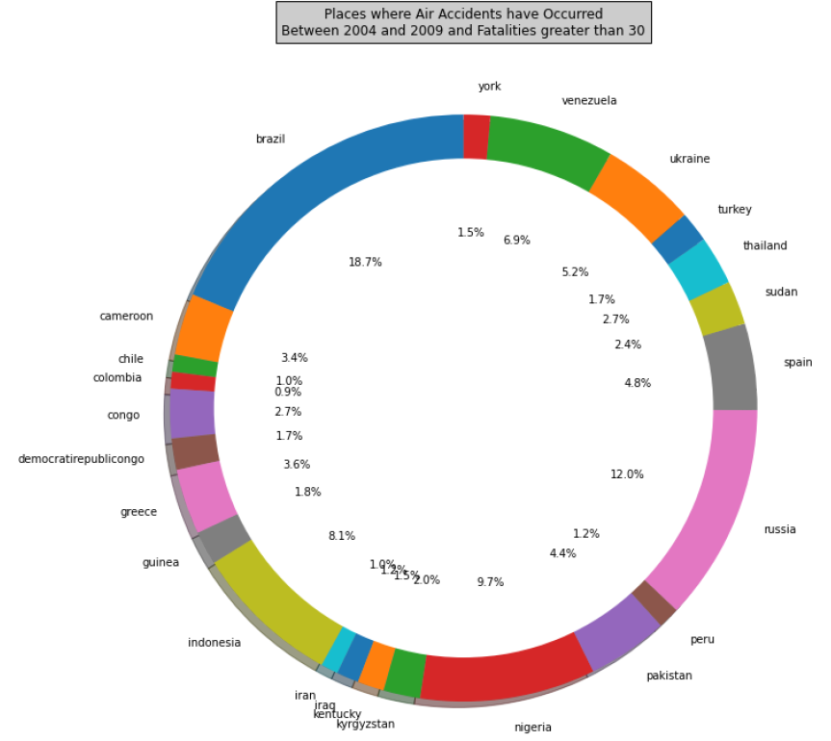

Slide 13
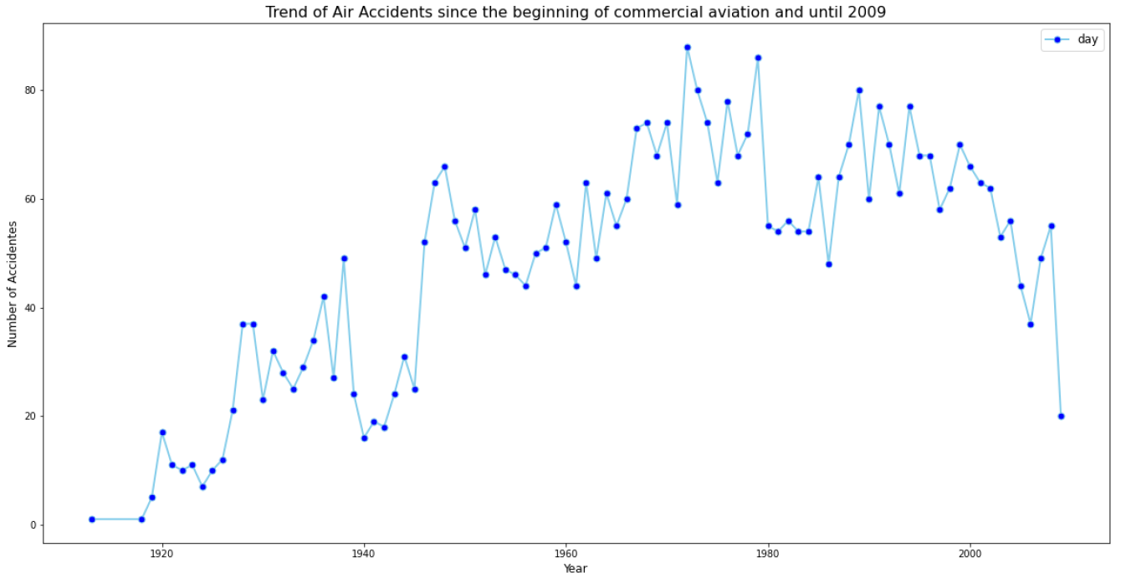

Slide 14
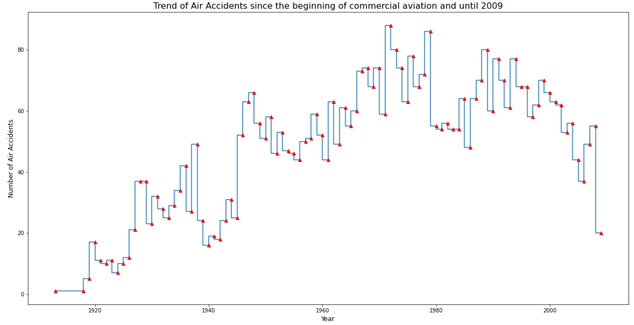

Slide 15
Conclusion
In the trends shown in the visualizations, we discovered, for example, that the fewer air accidents, the fewer passengers involved in air accidents. This means that the capacity of the aircraft has not increased much. On the other hand, for the peace of mind of the airlines and passengers, accidents have been decreasing since the 80s. Also, from these trends, we discovered the types of aircraft most involved in air accidents, McDonell and Tupolev.

